Slide 1


Data Mining and Data Warehousing
CSE-4107
Md. Manowarul Islam
Assistant Professor, Dept. of CSE
Jagannath University

Slide 2
Discovering Large Itemsets
Multiple passes over the data
First pass – count the support of individual items.
Subsequent pass
  Generate Candidates using previous pass’s large itemset.
  Go over the data and check the actual support of the candidates.
Stop when no new large itemsets are found.

Slide 3
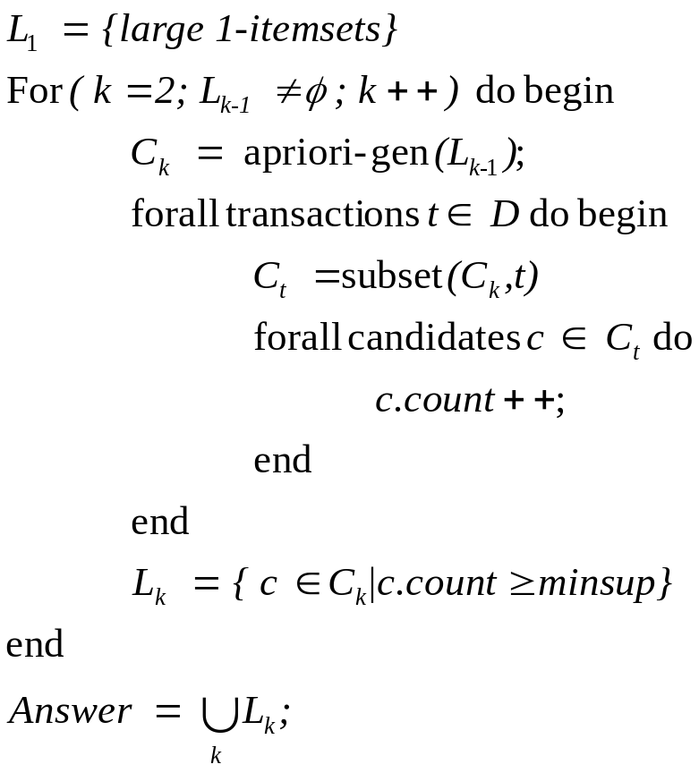
Algorithm Apriori
Count item occurrences
Generate new k-itemsets candidates
Find the support of all the candidates
Take only those with support over minsup

Slide 4

Problem?
Every pass goes over the whole data.

Slide 5
Apriori Problem
Database of transactions is massive
  Can be millions of transactions added an hour
Passing through database is expensive
  Later passes transactions don’t contain large itemsets
    Don’t need to check those transactions

Slide 6
Performance Bottlenecks
The core of the Apriori algorithm:
  Use frequent (k – 1)-itemsets to generate candidate frequent k-itemsets
  Use database scan and pattern matching to collect counts for the candidate itemsets
The bottleneck of Apriori: candidate generation
  Huge candidate sets:
    10⁴ frequent 1-itemset will generate 10⁷ candidate 2-itemsets
    To discover a frequent pattern of size 100, e.g., {a₁, a₂, …, a₁₀₀}, one needs to generate 2¹⁰⁰ ≈ 10³⁰ candidates.
  Multiple scans of database:
    Needs (n +1 ) scans, n is the length of the longest pattern

Slide 7
AprioriTid
A small variance of Apriori Algorithm
Still generate candidates
But does not use database for counting support after first database.

Slide 8
Algorithm AprioriTid
Uses the database only once.
Builds a storage set C^_{k}
  Members has the form < TID, {X_{k}} >
    X_{k} are potentially large k-items in transaction TID.
    For k=1, C^₁ is the database.
Uses C^_{k} in pass k+1.

Slide 9
Advantage
C^_{k} could be smaller than the database.
  If a transaction does not contain k-itemset candidates, than it will be excluded from C^_{k} .
For large k, each entry may be smaller than the transaction
  The transaction might contain only few candidates.

Slide 10
Disadvantage
Memory Overhead
For small k, each entry may be larger than the corresponding transaction.
  An entry includes all k-itemsets contained in the transaction.

Slide 11
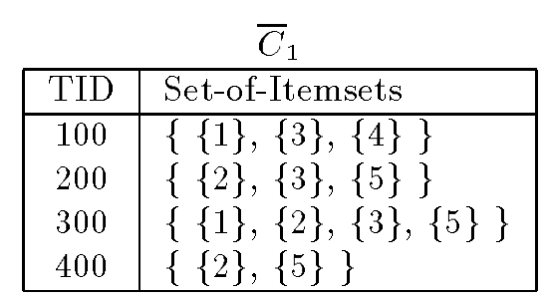
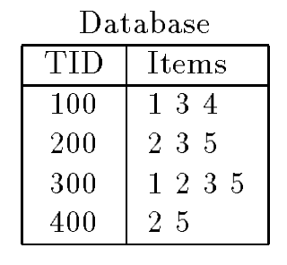
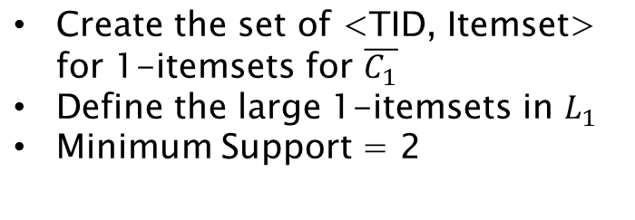
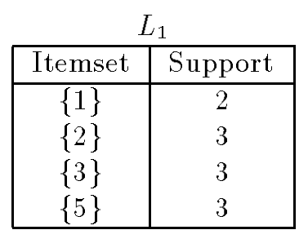
AprioriTid Example

Slide 12
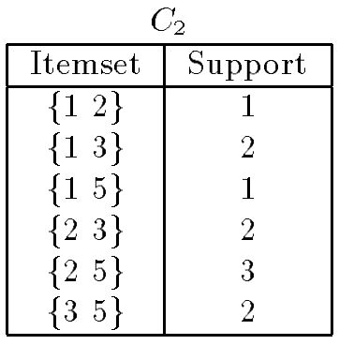
AprioriTid Example
Apriori-gen

Slide 13
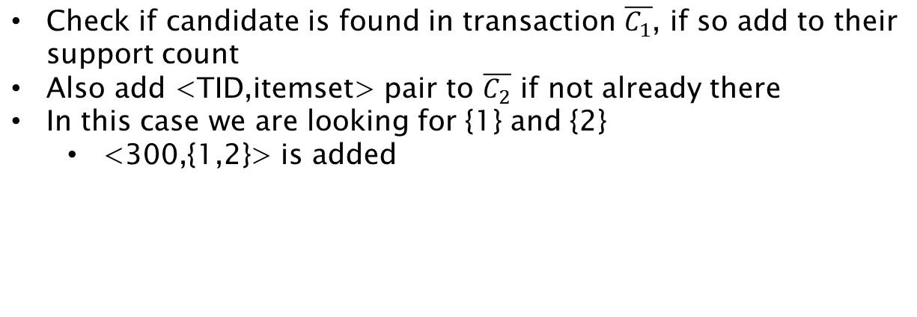
AprioriTid Example

Slide 14
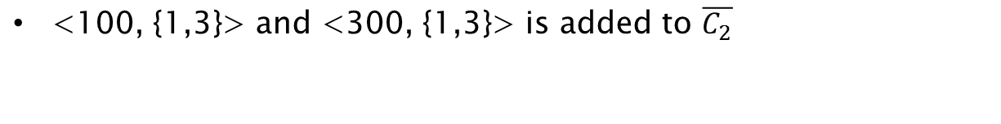
AprioriTid Example

Slide 15
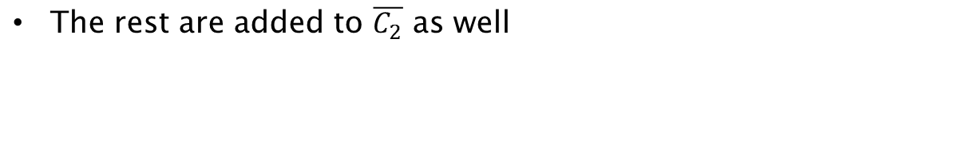
AprioriTid Example

Slide 16
AprioriTid Example

Slide 17
AprioriTid Example

Slide 18
AprioriTid Example

Slide 19
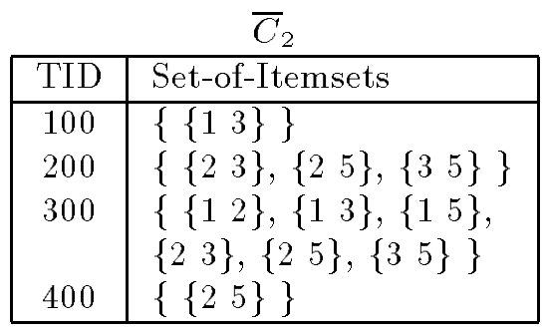

AprioriTid Example
By using C2 and find the

Slide 20
AprioriTid Example
By using C2 and find the

Slide 21
AprioriTid Example
By using C2 and find the

Slide 22

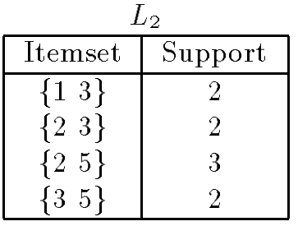
AprioriTid Example
Minimum Support = 2

Slide 23
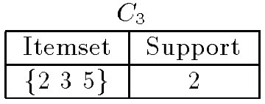
AprioriTid Example
Apriori-gen

Slide 24

AprioriTid Example

Slide 25
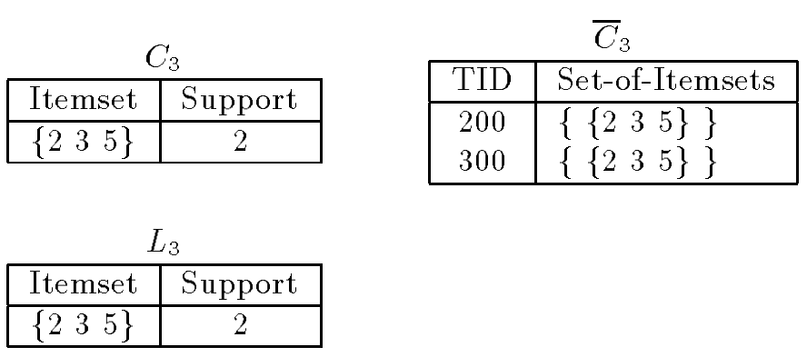
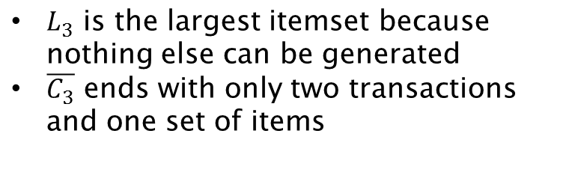
AprioriTid Example

Slide 26
Database
C^₁
L₁
TID | Items
100 | 1 3 4
200 | 2 3 5
300 | 1 2 3 5
400 | 2 5
TID | Set-of-itemsets
100 | { {1},{3},{4} }
200 | { {2},{3},{5} }
300 | { {1},{2},{3},{5} }
400 | { {2},{5} }
Itemset | Support
{1} | 2
{2} | 3
{3} | 3
{5} | 3
C₂
C^₂
L₂
itemset
{1 2}
{1 3}
{1 5}
{2 3}
{2 5}
{3 5}
TID | Set-of-itemsets
100 | { {1 3} }
200 | { {2 3},{2 5} {3 5} }
300 | { {1 2},{1 3},{1 5}, {2 3}, {2 5}, {3 5} }
400 | { {2 5} }
Itemset | Support
{1 3} | 2
{2 3} | 3
{2 5} | 3
{3 5} | 2
C^₃
L₃
C₃
TID | Set-of-itemsets
200 | { {2 3 5} }
300 | { {2 3 5} }
Itemset | Support
{2 3 5} | 2
itemset
{2 3 5}
Notes:
Minimum support = 2
C^2 גדול יותר אבל בשלב הבא נהיה קטן.

Slide 27

Example-2
Consider the transaction database in the first table below as an example.
Let consider, B=Bread, C=Cheese, E=Eggs, J=Juice and Y=Yogurt

Slide 28
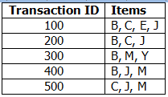
Example-2
Let consider, B=Bread, C=Cheese, E=Eggs, J=Juice and Y=Yogurt

Slide 29
Example-2
C^₁
Transaction | Items
100 | {B}{C}{E}{J}
200 | {B}{C}{J}
300 | {B}{M}{Y}
400 | {B}{J}{M}
500 | {C}{J}{M}
Support = 50%=3

Slide 30
Example-2
C^₁
Generate C1
Transaction | Items
100 | {B}{C}{E}{J}
200 | {B}{C}{J}
300 | {B}{M}{Y}
400 | {B}{J}{M}
500 | {C}{J}{M}
ITEM | Support Count
{B} | 4
{C} | 3
{E} | 1
{J} | 4
{M} | 3
{Y} | 1

Slide 31
Example-2
C^₁
Generate L1
Transaction | Items
100 | {B}{C}{E}{J}
200 | {B}{C}{J}
300 | {B}{M}{Y}
400 | {B}{J}{M}
500 | {C}{J}{M}
ITEM | Support Count
{B} | 4
{C} | 3
{J} | 4
{M} | 3

Slide 32
Example-2
C2
Generate C2
ITEM
{B,C}
{B,J}
{B,M}
{C,J}
{C,M}
{J,M}
L1
ITEM | Support Count
{B} | 4
{C} | 3
{J} | 4
{M} | 3

Slide 33
Example-2
Count the support from C^₁
C2
ITEM | Support
{B,C} | 2
{B,J}
{B,M}
{C,J}
{C,M}
{J,M}
Transaction | Items
100 | {B}{C}{E}{J}
200 | {B}{C}{J}
300 | {B}{M}{Y}
400 | {B}{J}{M}
500 | {C}{J}{M}

Slide 34
Example-2
Count the support from C^₁
C2
ITEM | Support
{B,C} | 2
{B,J} | 3
{B,M}
{C,J}
{C,M}
{J,M}
Transaction | Items
100 | {B}{C}{E}{J}
200 | {B}{C}{J}
300 | {B}{M}{Y}
400 | {B}{J}{M}
500 | {C}{J}{M}

Slide 35
Example-2
Count the support from C^₁
C2
ITEM | Support
{B,C} | 2
{B,J} | 3
{B,M} | 2
{C,J} | 3
{C,M} | 1
{J,M} | 2
Transaction | Items
100 | {B}{C}{E}{J}
200 | {B}{C}{J}
300 | {B}{M}{Y}
400 | {B}{J}{M}
500 | {C}{J}{M}

Slide 36
Example-2
By using C2 and C^₁ find the C^₂
Transaction | Items
100 | {B}{C}{E}{J}
200 | {B}{C}{J}
300 | {B}{M}{Y}
400 | {B}{J}{M}
500 | {C}{J}{M}
C2
ITEM | Support
{B,C} | 2
{B,J} | 3
{B,M} | 2
{C,J} | 3
{C,M} | 1
{J,M} | 2
C^₁
Transaction | Items
100 | {{B,C},{B,J},{C,J}}
C^₂

Slide 37
Example-2
By using C2 and C^₁ find the C^₂
Transaction | Items
100 | {B}{C}{E}{J}
200 | {B}{C}{J}
300 | {B}{M}{Y}
400 | {B}{J}{M}
500 | {C}{J}{M}
C2
ITEM | Support
{B,C} | 2
{B,J} | 3
{B,M} | 2
{C,J} | 3
{C,M} | 1
{J,M} | 2
C^₁
Transaction | Items
100 | {{B,C},{B,J},{C,J}}
200 | {{B,C},{B,J},{C,J}}
C^₂

Slide 38
Example-2
By using C2 and C^₁ find the C^₂
Transaction | Items
100 | {B}{C}{E}{J}
200 | {B}{C}{J}
300 | {B}{M}{Y}
400 | {B}{J}{M}
500 | {C}{J}{M}
C2
ITEM | Support
{B,C} | 2
{B,J} | 3
{B,M} | 2
{C,J} | 3
{C,M} | 1
{J,M} | 2
C^₁
Transaction | Items
100 | {{B,C},{B,J},{C,J}}
200 | {{B,C},{B,J},{C,J}}
300 | {{B,M}}
C^₂

Slide 39
Example-2
By using C2 and C^₁ find the C^₂
Transaction | Items
100 | {B}{C}{E}{J}
200 | {B}{C}{J}
300 | {B}{M}{Y}
400 | {B}{J}{M}
500 | {C}{J}{M}
C2
ITEM | Support
{B,C} | 2
{B,J} | 3
{B,M} | 2
{C,J} | 3
{C,M} | 1
{J,M} | 2
C^₁
Transaction | Items
100 | {{B,C},{B,J},{C,J}}
200 | {{B,C},{B,J},{C,J}}
300 | {{B,M}}
400 | {{B,J}, {B,M},{J,M}}
500
C^₂

Slide 40
Example-2
By using C2 and C^₁ find the C^₂
Transaction | Items
100 | {B}{C}{E}{J}
200 | {B}{C}{J}
300 | {B}{M}{Y}
400 | {B}{J}{M}
500 | {C}{J}{M}
C2
ITEM | Support
{B,C} | 2
{B,J} | 3
{B,M} | 2
{C,J} | 3
{C,M} | 1
{J,M} | 2
C^₁
Transaction | Items
100 | {{B,C},{B,J},{C,J}}
200 | {{B,C},{B,J},{C,J}}
300 | {{B,M}}
400 | {{B,J}, {B,M},{J,M}}
500 | {{C,J}{C,M}{J,M}}
C^₂

Slide 41
Example-2
Find the frequent set L2
C^₂
C2
Transaction | Items
100 | {{B,C},{B,J},{C,J}}
200 | {{B,C},{B,J},{C,J}}
300 | {{B,M}}
400 | {{B,J}, {B,M},{J,M}}
500 | {{C,J}{C,M}{J,M}}
ITEM | Support
{B,C} | 2
{B,J} | 3
{B,M} | 2
{C,J} | 3
{C,M} | 1
{J,M} | 2
ITEM | Support
{B,J} | 3
{C,J} | 3
L2

Slide 42
Example-2
Find the C3
L2
C3
ITEM | Support
{B,J} | 3
{C,J} | 3
ITEM
{B,C,J}
But actually it is empty because subset {BC} is infrequent

Slide 43
Advantages
Size of the database C^_{k} is decreasing gradually than the original database.
It is faster than Apriori algorithm.

Slide 44
Thank you

